Slide 1
Blacktown Chinese Christian Church
Welcome to Our English Service 01.02.2026
English Service 9:45 – 11:00 am
Worship Songs: Passage: Speaker: Topic: Response Song: Announcements and Closing Prayer Benediction
Gal 1:10-12 Xavier Lakshmanan Pleasing Men or God? TBA

Slide 2
BCCC english service

Slide 3
Thrive
Mark Hall, Matthew West © 2014 Be Essential Songs (Admin. by Essential Music Publishing LLC) My Refuge Music (Admin. by Essential Music Publishing LLC) Matthew West (Combustion) (Admin. by Mushroom Music Publishing) Remaining portion is unaffiliated CCLI Licence No. 5485849 . CCLI Song number: 7006228

Slide 4
Here in this worn and weary land
Where many a dream has died
Like a tree planted by the water
We never will run dry

Slide 5
So living water flowing through
God we thirst for more of You
Fill our hearts and flood our souls
With one desire

Slide 6
Just to know You and
To make You known
We lift Your name on High
Shine like the sun make darkness run and hide

Slide 7
We know we were made for so much more
Than ordinary lives
It's time for us to more than just survive
We were made to thrive

Slide 8
Into Your word we're digging deep
To know our Father's heart
Into the world we're reaching out
To show them who You are

Slide 9
So living water flowing through
God we thirst for more of You
Fill our hearts and flood our souls
With one desire

Slide 10
Just to know You and
To make You known
We lift Your name on High
Shine like the sun make darkness run and hide

Slide 11
We know we were made for so much more
Than ordinary lives
It's time for us to more than just survive
We were made to thrive

Slide 12
Joy Unspeakable, Faith Unsinkable
Love Unstoppable, Anything is possible
Joy Unspeakable, Faith Unsinkable
Love Unstoppable, Anything is possible (x2)

Slide 13
Just to know You and
To make You known
We lift Your name on High
Shine like the sun make darkness run and hide

Slide 14
We know we were made for so much more
Than ordinary lives
It's time for us to more than just survive
We were made to thrive

Slide 15
We were made to thrive

Slide 16
Jerusalem
Jonny Robinson, Rich Thompson, Tiarne Tranter © 2014 CityAlight Music (Admin. by Integrity Music) CCLI Licence No. 5485849 . CCLI Song number: 7003218

Slide 17
See Him in Jerusalem
Walking where the crowds are
Once these streets had sung to Him
Now they cry for murder

Slide 18
Such a frail and lonely man
Holding up the heavy cross
See Him walking in Jerusalem
On the road to save us

Slide 19
See him there upon the hill
Hear the scorn and laughter
Silent as a lamb he waits
Praying to the father

Slide 20
See the king who made the sun
And the moon and shining stars
Let the soldiers hold and nail him down
So that he could save them

Slide 21
See him there upon the cross
Now no longer breathing
Dust that formed the watching crowds
Takes the blood of Jesus

Slide 22
Feel the earth is shaking now
See the veil is split in two
And he stood before the wrath of God
Shielding sinners with his blood

Slide 23
See the empty tomb today
Death could not contain him
Once the servant of the world
Now in victory reigning

Slide 24
Lift your voices to the one
Who is seated on the throne
See him in the new Jerusalem
Praise the one who saved us (x2)

Slide 25
Praise the one who saved us

Slide 26
Above All
Lenny LeBlanc, Paul Baloche © 1999 Integrity's Hosanna! Music (Admin. by Integrity Music) LenSongs Publishing (Admin. by LenSongs Publishing, Inc.) CCLI Licence No. 5485849 . CCLI Song number: 2672885

Slide 27
Above all powers, above all kings
Above all nature and all created things
Above all wisdom and all the ways of man
You were here before the world began

Slide 28
Above all kingdoms, above all thrones
Above all wonders the world has ever known
Above all wealth and treasures of the earth
There's no way to measure what You're worth

Slide 29
Crucified, laid behind a stone
You lived to die, rejected and alone
Like a rose, trampled on the ground
You took the fall and thought of me, above all

Slide 30
Above all powers, above all kings
Above all nature and all created things
Above all wisdom and all the ways of man
You were here before the world began

Slide 31
Above all kingdoms, above all thrones
Above all wonders the world has ever known
Above all wealth and treasures of the earth
There's no way to measure what You're worth

Slide 32
Crucified, laid behind a stone
You lived to die, rejected and alone
Like a rose, trampled on the ground
You took the fall and thought of me, above all (x2)

Slide 33
Like a rose, trampled on the ground
You took the fall and thought of me
Above all

Slide 34
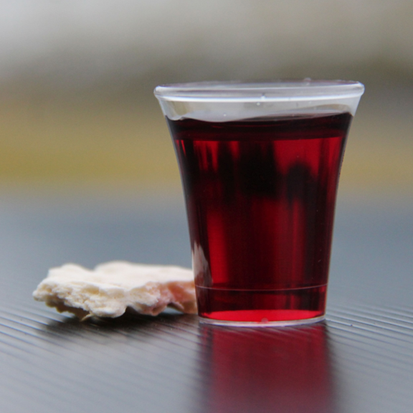
Holy Communion

Slide 35

Bible reading

Slide 36
Gal 1:10-12
¹⁰ Am I now trying to win the approval of human beings, or of God? Or am I trying to please people? If I were still trying to please people, I would not be a servant of Christ.
¹¹ I want you to know, brothers and sisters, that the gospel I preached is not of human origin.

Slide 37
Gal 1:10-12
¹² I did not receive it from any man, nor was I taught it; rather, I received it by revelation from Jesus Christ.

Slide 38
My Lighthouse
Chris Llewellyn, Gareth Gilkeson © 2013 Thankyou Music (Admin. by SHOUT! Music Publishing Australia) CCLI Licence No. 5485849 . CCLI Song number: 7002032

Slide 39
In my wrestling and in my doubts
In my failures You won't walk out

Slide 40
Your great love will lead me through
You are the peace in my troubled sea
You are the peace in my troubled sea

Slide 41
In the silence, You won't let go
In my questions, Your truth will hold

Slide 42
Your great love will lead me through
You are the peace in my troubled sea
You are the peace in my troubled sea

Slide 43
My lighthouse
My lighthouse
Shining in the darkness
I will follow You

Slide 44
My lighthouse
My lighthouse
I will trust the promise
You will carry me safe to shore

Slide 45
Safe to shore
Safe to shore
Safe to shore

Slide 46
I won't fear what tomorrow brings
With each morning I'll rise and sing

Slide 47
My God's love will lead me through
You are the peace in my troubled sea
You are the peace in my troubled sea

Slide 48
My lighthouse
My lighthouse
Shining in the darkness
I will follow You

Slide 49
My lighthouse
My lighthouse
I will trust the promise
You will carry me safe to shore

Slide 50
Safe to shore
Safe to shore
Safe to shore

Slide 51
Fire before us, You're the brightest
You will lead us through the storms (x4)

Slide 52
My lighthouse
My lighthouse
Shining in the darkness
I will follow You

Slide 53
My lighthouse
My lighthouse
I will trust the promise
You will carry me safe to shore

Slide 54
Safe to shore
Safe to shore
Safe to shore

Slide 55
Announcements

Slide 56





Account name: Blacktown Chinese Christian Church
Account number: 4216 50263
Offering
BSB: 112 - 879
Please put in "offering" as the reference
The offering box is available at the back of the hall

Slide 57
Prayer points

Slide 58
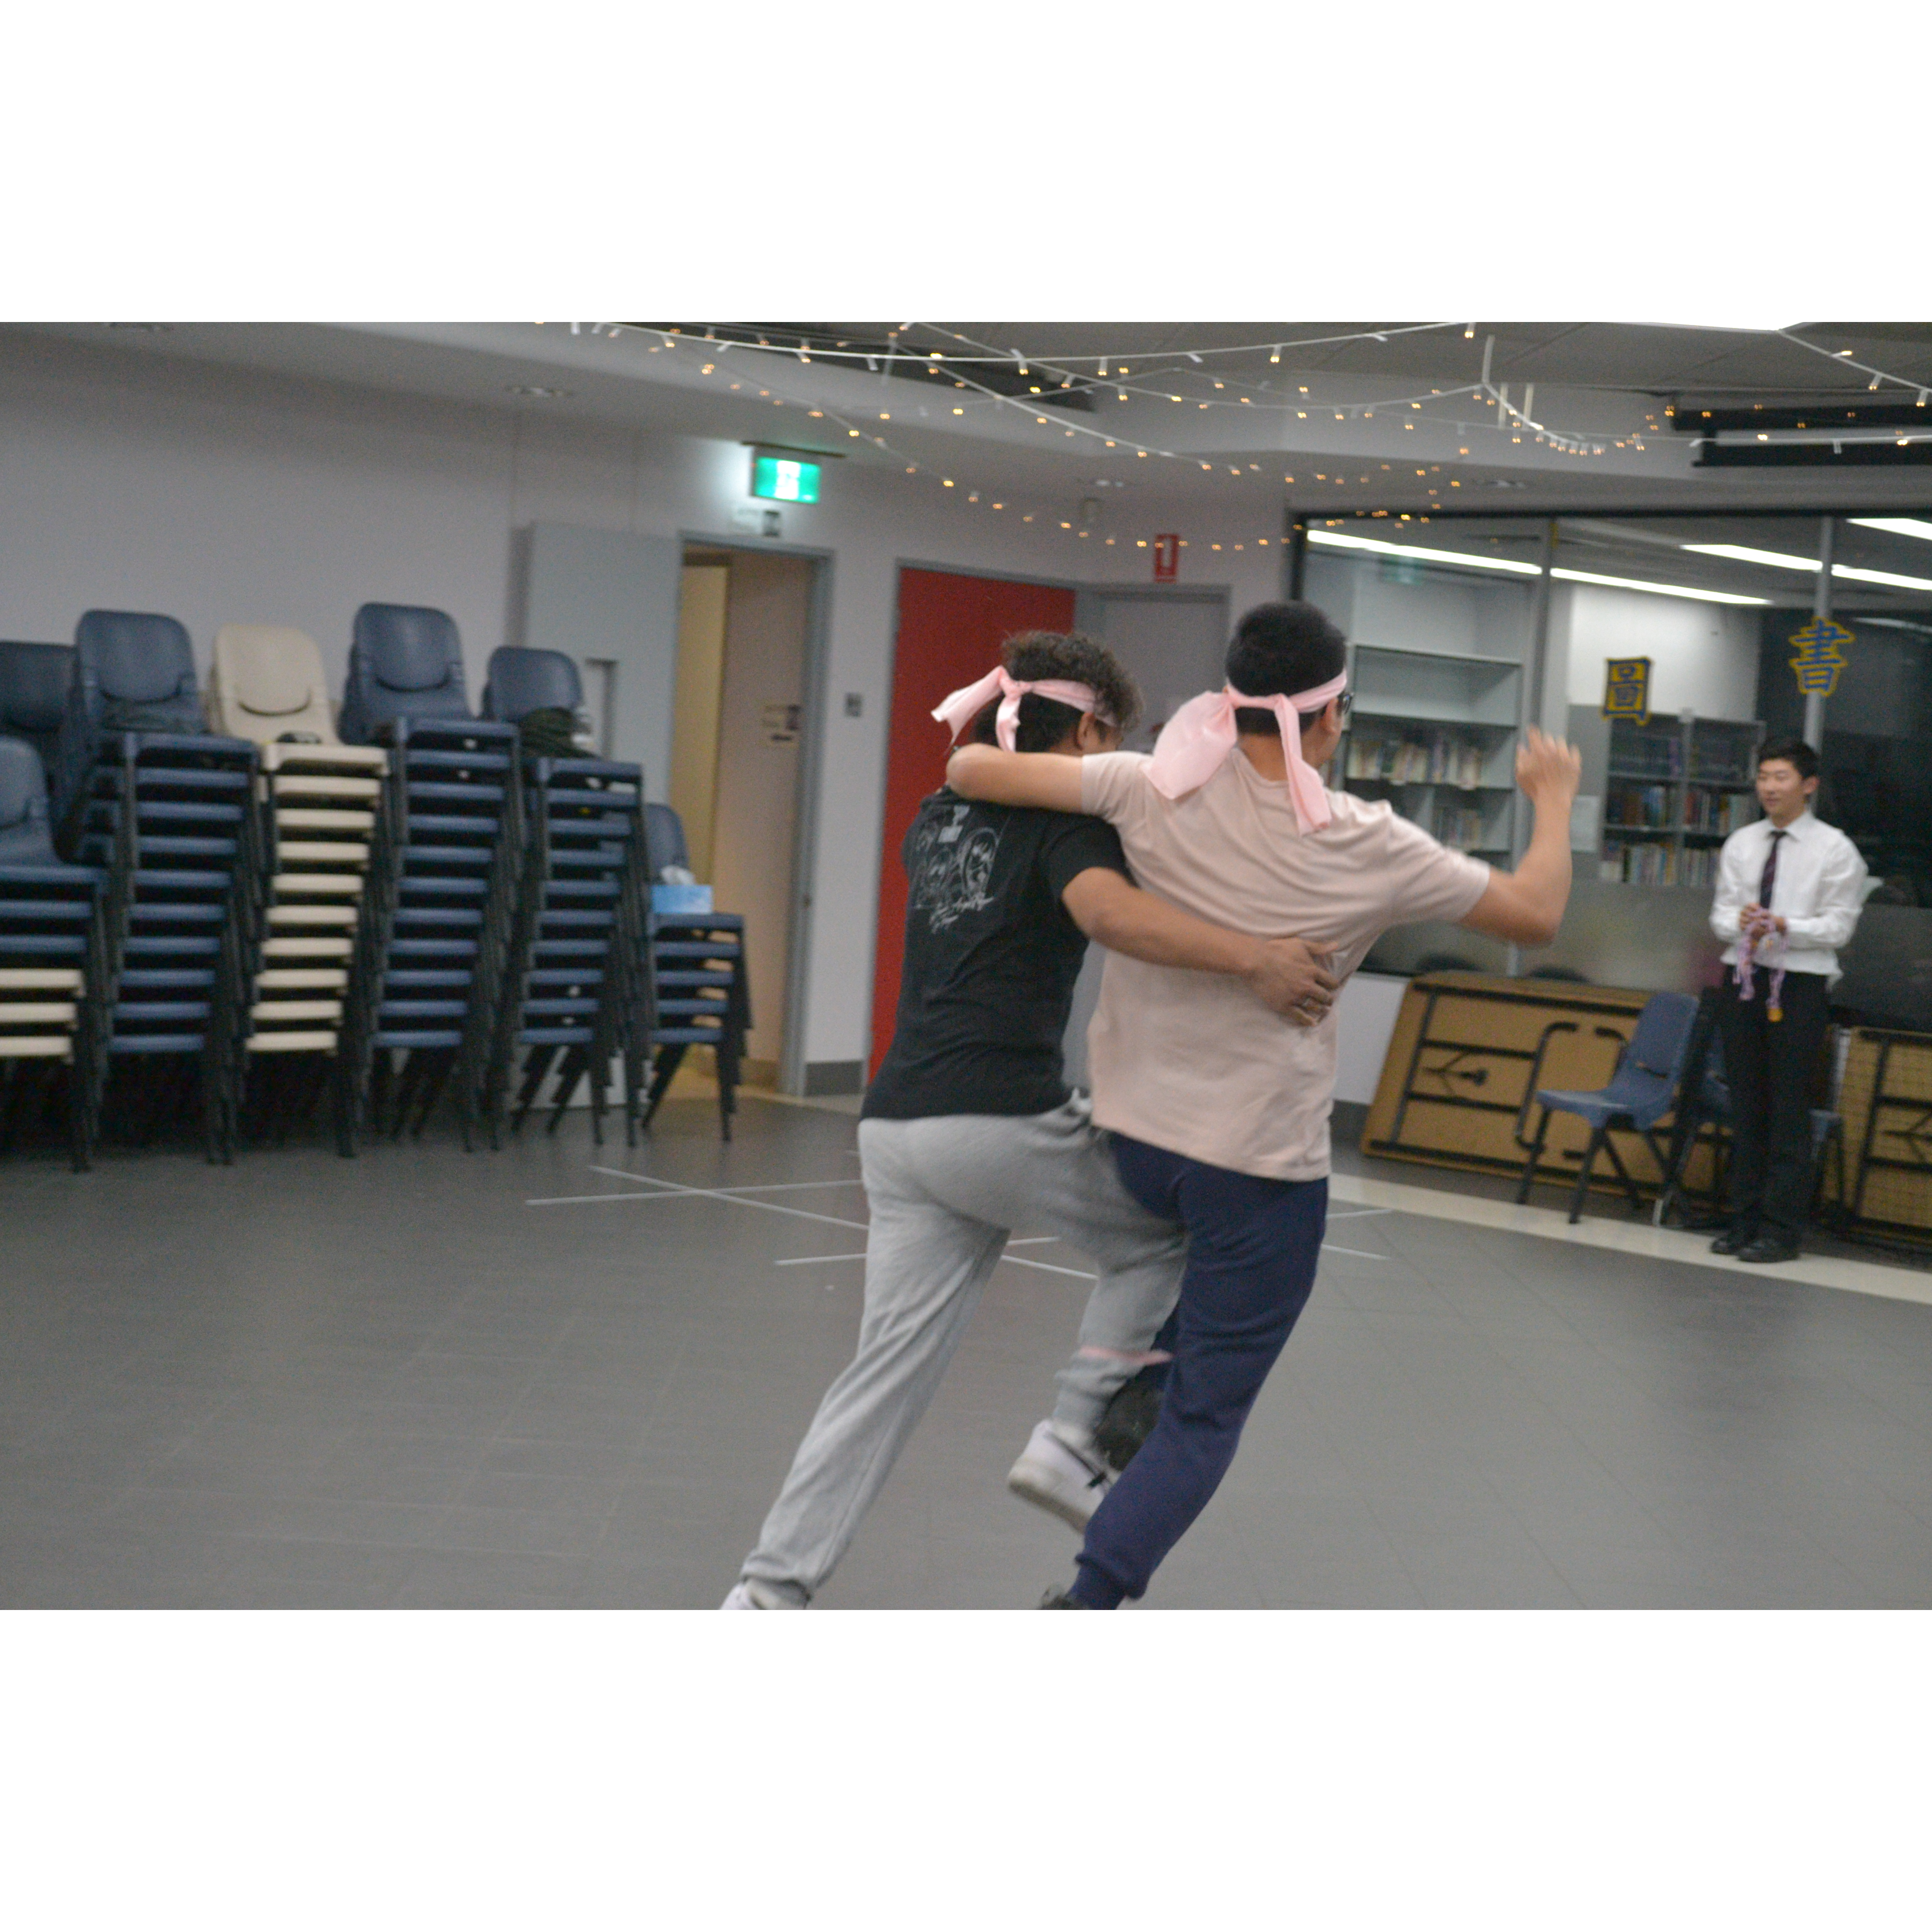
Mingle time!

